Slide 1
School of Computing Science and Engineering
Course Code: BTCS9401
Course Name: Data Science
UNIT -4
Faculty Name: Dr. Biswa Mohan Sahoo
Program Name: B.Tech

Slide 2
COURSE OBJECTIVE
Understand concepts of data science.
Understand popular tools of data analysis.
Learn data science in python.
Apply different visualization Techniques on datasets.
Implement learning techniques in data science.

Slide 3
Introduction to Data Visualizations
Data visualization is the graphical or visual representation of data. It helps to highlight the most useful insights from a dataset, making it easier to spot trends, patterns, outliers, and correlations.
What are the two main types of data visualization?
Exploration vs. explanation
Exploration data visualization helps you figure out what’s in your data, while exploratory visualization helps you to communicate what you’ve found.
Explanation takes place while you’re still analyzing the data, while explanation comes towards the end of the process when you’re ready to share your findings.

Slide 4
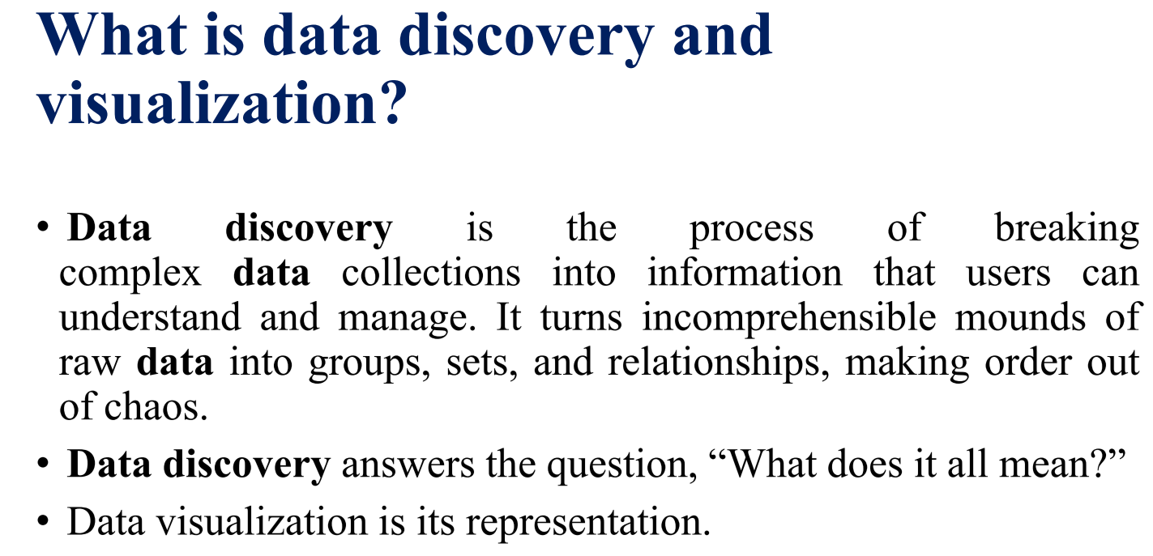
Data Visualizations

Slide 5
The advantages and benefits of effective data visualization
Data visualization allows you to:
Get an initial understanding of your data by making trends, patterns, and outliers easily visible to the naked eye
Comprehend large volumes of data quickly and efficiently
Communicate insights and findings to non-data experts, making your data accessible and actionable
Tell a meaningful and impactful story, highlighting only the most relevant information for a given context

Slide 6
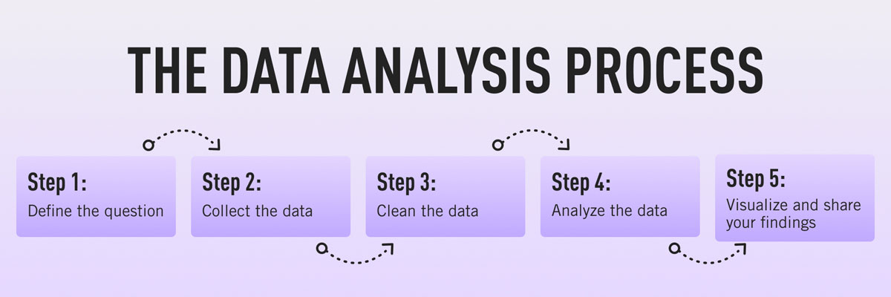
When should you visualize your data?
Aside from exploratory data visualization which takes place in the early stages, data visualization usually comprises the final step in the data analysis process. To recap, the data analysis process can be set out as follows:

Slide 7
When should you visualize your data?
Define the question: What problem are you trying to solve?
Collect the data: Determine what kind of data you need and where you’ll find it.
Clean the data: Remove errors, duplicates, outliers, and unwanted data points—anything that might skew how your data is interpreted.
Analyze the data: Determine the type of data analysis you need to carry out in order to find the insights you’re looking for.
Visualize the data and share your findings: Translate your key insights into visual format (e.g. graphs, charts, or heatmaps) and present them to the relevant audience(s).

Slide 8
What is data visualization used for?
Within the broader goal of conveying key insights, different visualizations can be used to tell different stories. Data visualizations can be used to:
Convey changes over time: For example, a line graph could be used to present how the value of Bitcoin changed over a certain time period.
Determine the frequency of events: You could use a histogram to visualize the frequency distribution of a single event over a certain time period
Highlight interesting relationships or correlations between variables: If you wanted to highlight the relationship between two variables a certain network (for example, your entire customer base), network visualizations can help you to identify (and depict) meaningful connections and clusters within your network of interest.
Analyze value and risk: If you want to weigh up value versus risk in order to figure out which opportunities or strategies are worth pursuing, data visualizations—such as a color-coded system—could help you to categorize and identify, at a glance, which items are feasible.

Slide 9
How to visualize your data: Different types of data visualization categories
There are many different options when it comes to visualizing your data. The visualization you choose depends on the type of data you’re working with and what you want to convey or highlight. It’s also important to consider the complexity of your data and how many different variables are involved. Not all types of data visualization lend themselves to elaborate or complex depictions, so it’s important to choose a suitable technique.
Before we explore some of the most common types of data visualization, let’s first introduce five main data visualization categories.

Slide 10
Five data visualization categories
Temporal data visualizations are linear and one-dimensional. Examples include scatterplots, timelines, and line graphs.
Hierarchical visualizations organize groups within larger groups, and are often used to display clusters of information. Examples include tree diagrams, ring charts, and sunburst diagrams.
Network visualizations show the relationships and connections between multiple datasets. Examples include matrix charts, word clouds, and node-link diagrams.
Multidimensional or 3D visualizations are used to depict two or more variables. Examples include pie charts, Venn diagrams, stacked bar graphs, and histograms.
Geospatial visualizations convey various data points in relation to physical, real-world locations (for example, voting patterns across a certain country). Examples include heat maps, cartograms, and density maps.

Slide 11
Principles Behind Data Visualizations
Clarity
Precision
Efficiency
Maximize ideas, minimize ink

Slide 12
What are the advantages and disadvantages of data visualization?
Advantages
Easily sharing information.
Interactively explore opportunities.
Visualize patterns and relationships.
Disadvantages
Biased or inaccurate information.
Correlation doesn’t always mean causation.
Core messages can get lost in translation.

Slide 13
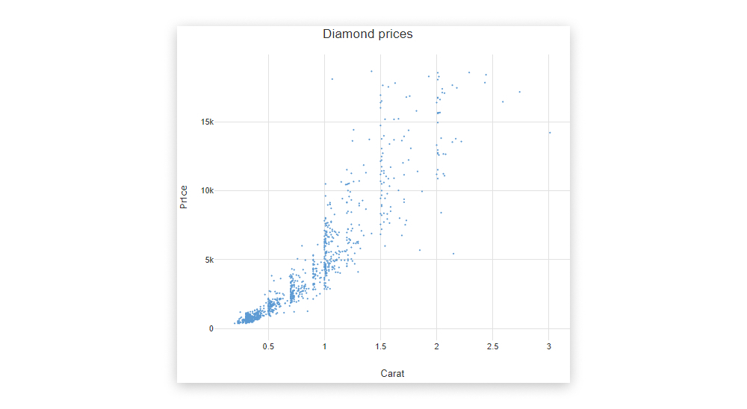
Five common types of data visualization
1. Scatterplots
Scatterplots (or scatter graphs) visualize the relationship between two variables. One variable is shown on the x-axis, and the other on the y-axis, with each data point depicted as a single “dot” or item on the graph. This creates a “scatter” effect, hence the name.

Slide 14
Five common types of data visualization
2. Bar charts
Bar charts are used to plot categorical data against discrete values. Categorical data refers to data that is not numeric, and it’s often used to describe certain traits or characteristics. Some examples of categorical data include things like education level (e.g. high school, undergrad, or post-grad) and age group (e.g. under 30, under 40, under 50, or 50 and over). Discrete values are those which can only take on certain values—there are no “half measures” or “gray areas.”

Slide 15
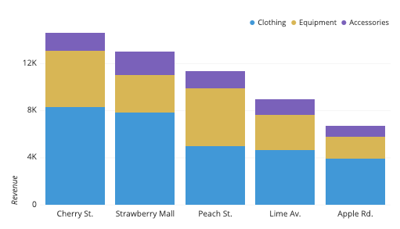
Five common types of data visualization
Example:

Slide 16
Five common types of data visualization
3. Pie charts
Just like bar charts, pie charts are used to visualize categorical data. However, while bar charts represent multiple categories of data, pie charts are used to visualize just one single variable broken down into percentages or proportions. A pie chart is essentially a circle divided into different “slices,” with each slice representing the percentage it contributes to the whole. Thus, the size of each pie slice is proportional to how much it contributes to the whole “pie.”

Slide 17
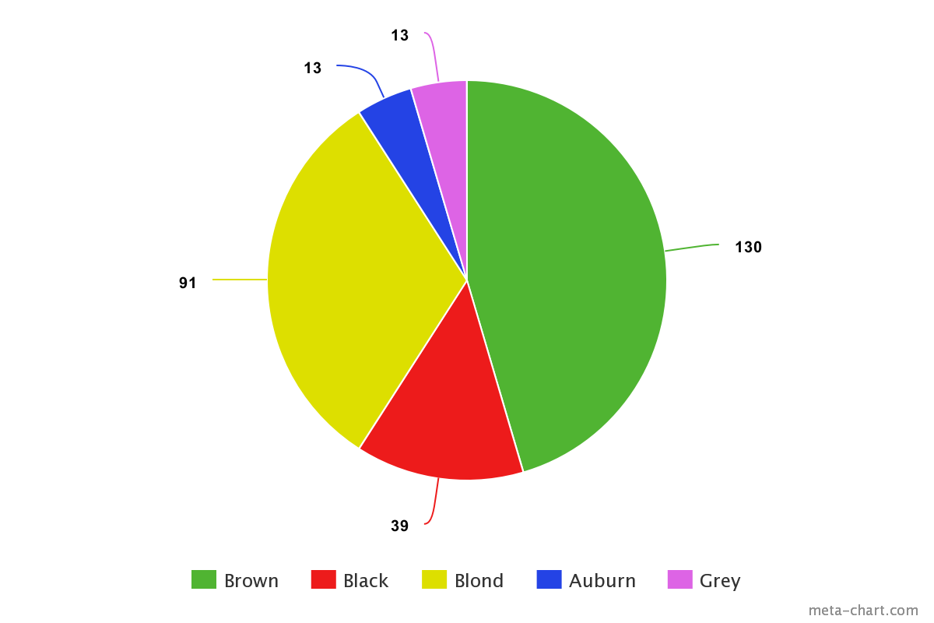
Five common types of data visualization
Example:

Slide 18
Five common types of data visualization
4. Network graphs
Not all data is simple enough to be summarized in a bar or pie chart. For those more complex datasets, there are a range of more elaborate data visualizations at your disposal—network graphs being one of them. Network graphs show how different elements or entities within a network relate to one another, with each element represented by an individual node. These nodes are connected to other, related nodes via lines.

Slide 19
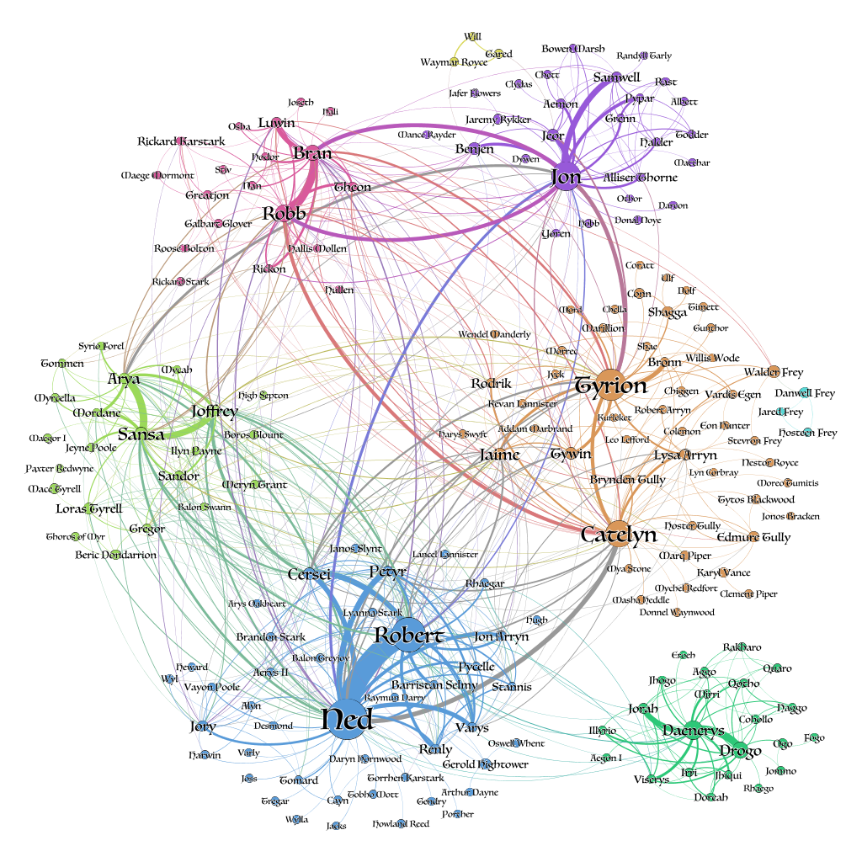
Five common types of data visualization
Example:

Slide 20
Five common types of data visualization
5. Geographical maps
Geo maps are used to visualize the distribution of data in relation to a physical, geographical area. For example, you could use a color-coded map to see how natural oil reserves are distributed across the world, or to visualize how different states voted in a political election. Maps are an extremely versatile form of data visualization, and are an excellent way of communicating all kinds of location-related data. Some other types of maps used in data visualization include dot distribution maps (think scatterplots combined with a map), and cartograms which distort the size of geographical areas to proportionally represent a given variable (population density, for example).

Slide 21
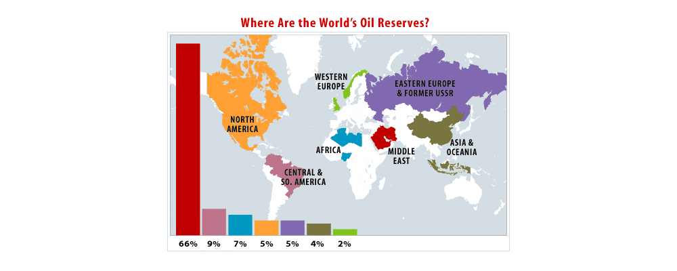
Five common types of data visualization
Example:

Slide 22
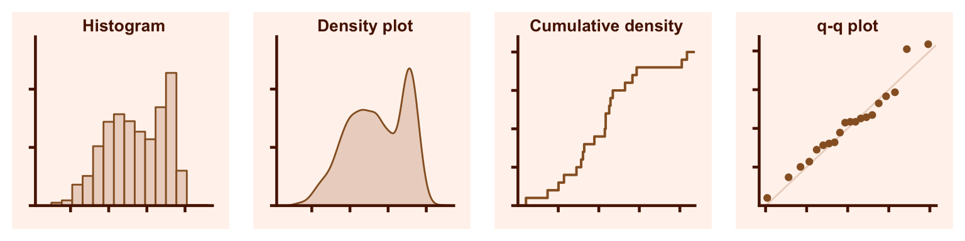
Types of Visualizations: Distributions

Slide 23
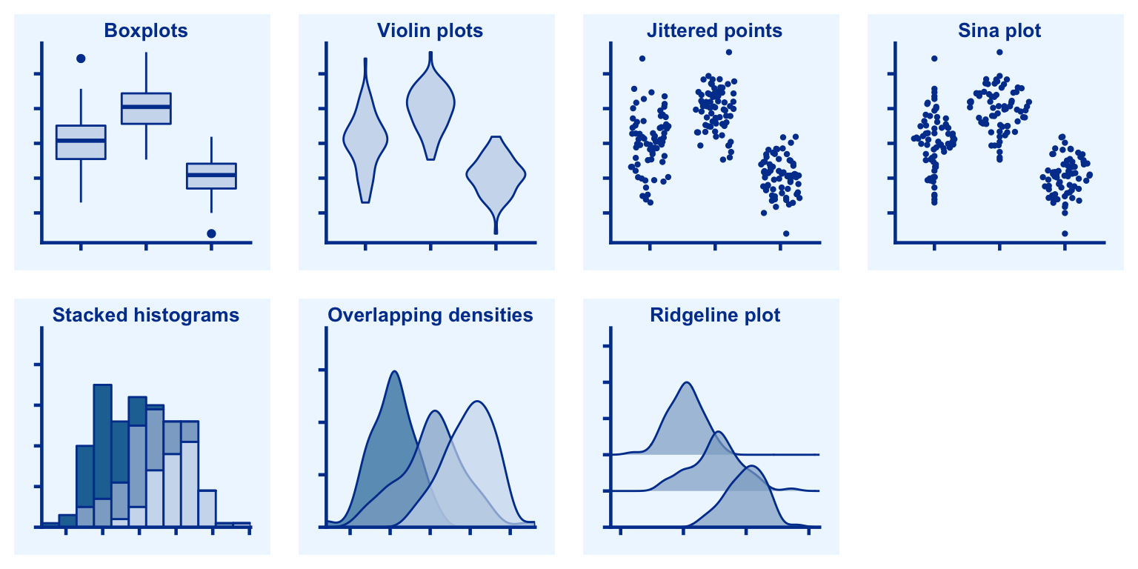
Types of Visualizations: Multiple Distributions

Slide 24
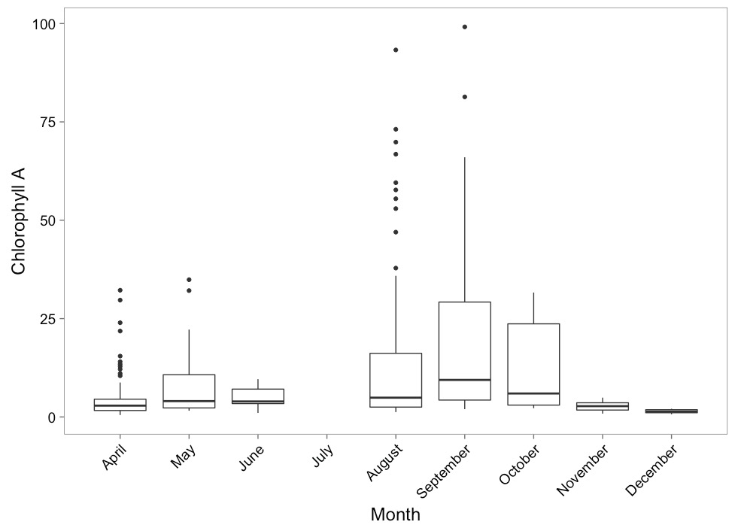
Boxplots to Show Variation

Slide 25
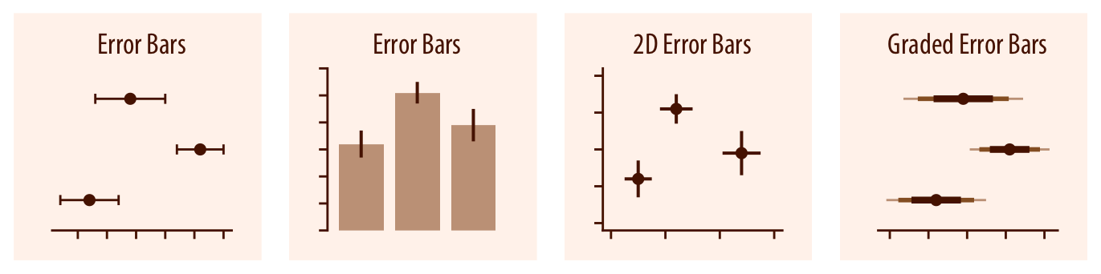
Visualizing Uncertainty is Difficult

Slide 26
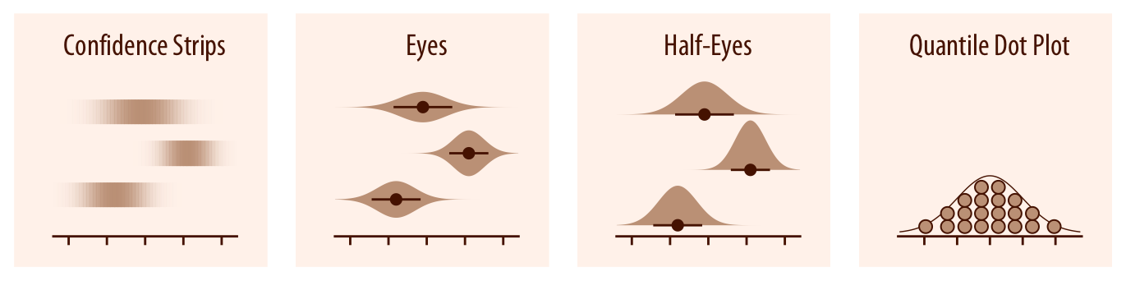
Visualizing Distributions versus Uncertainty

Slide 27
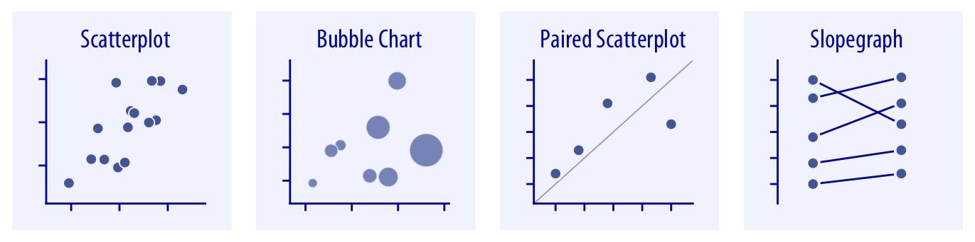
Relationships Between Variables
Example:

Slide 28
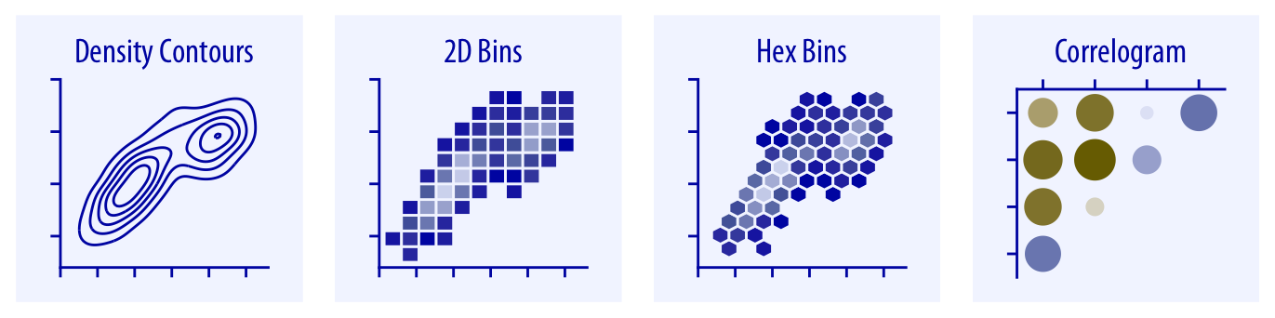
Relationships Between Variables With a Lot of Data

Slide 29
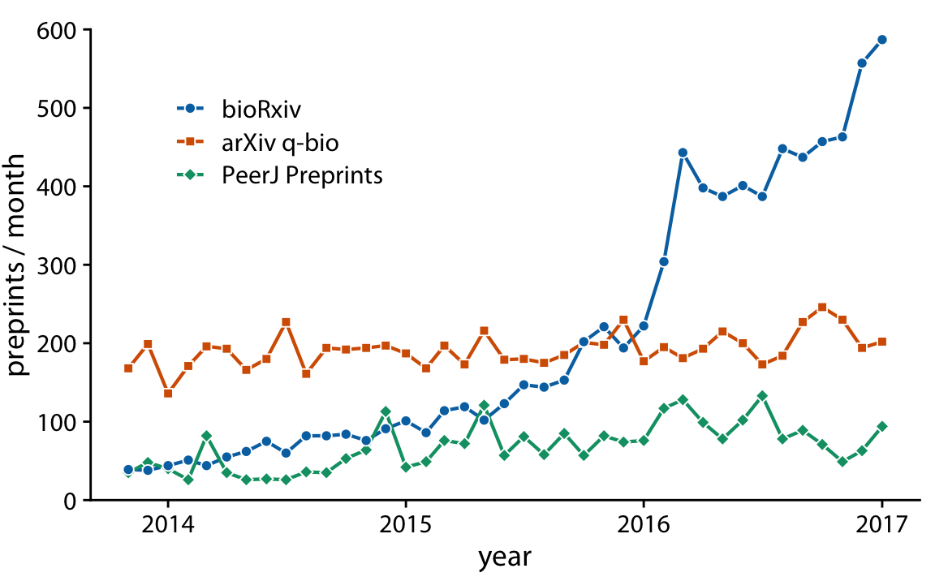
Should Your Data Be Connected?

Slide 30
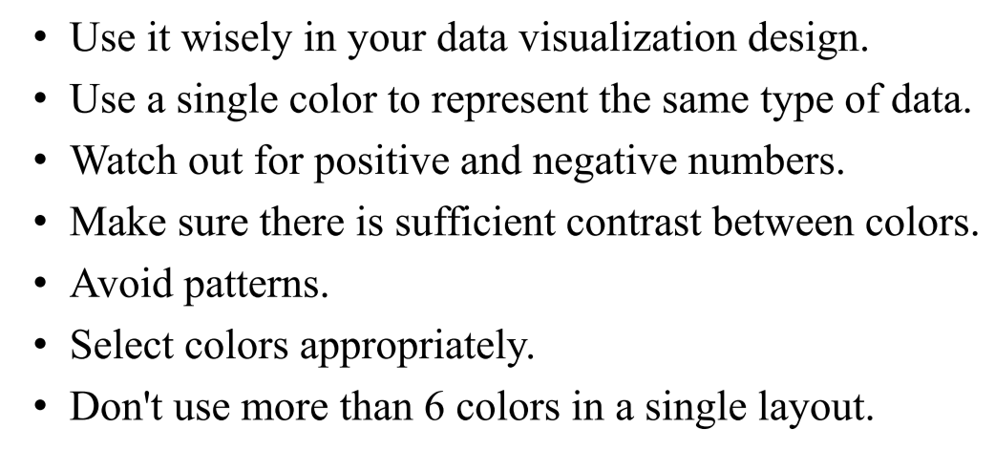
How do you create good data visualization?

Slide 31
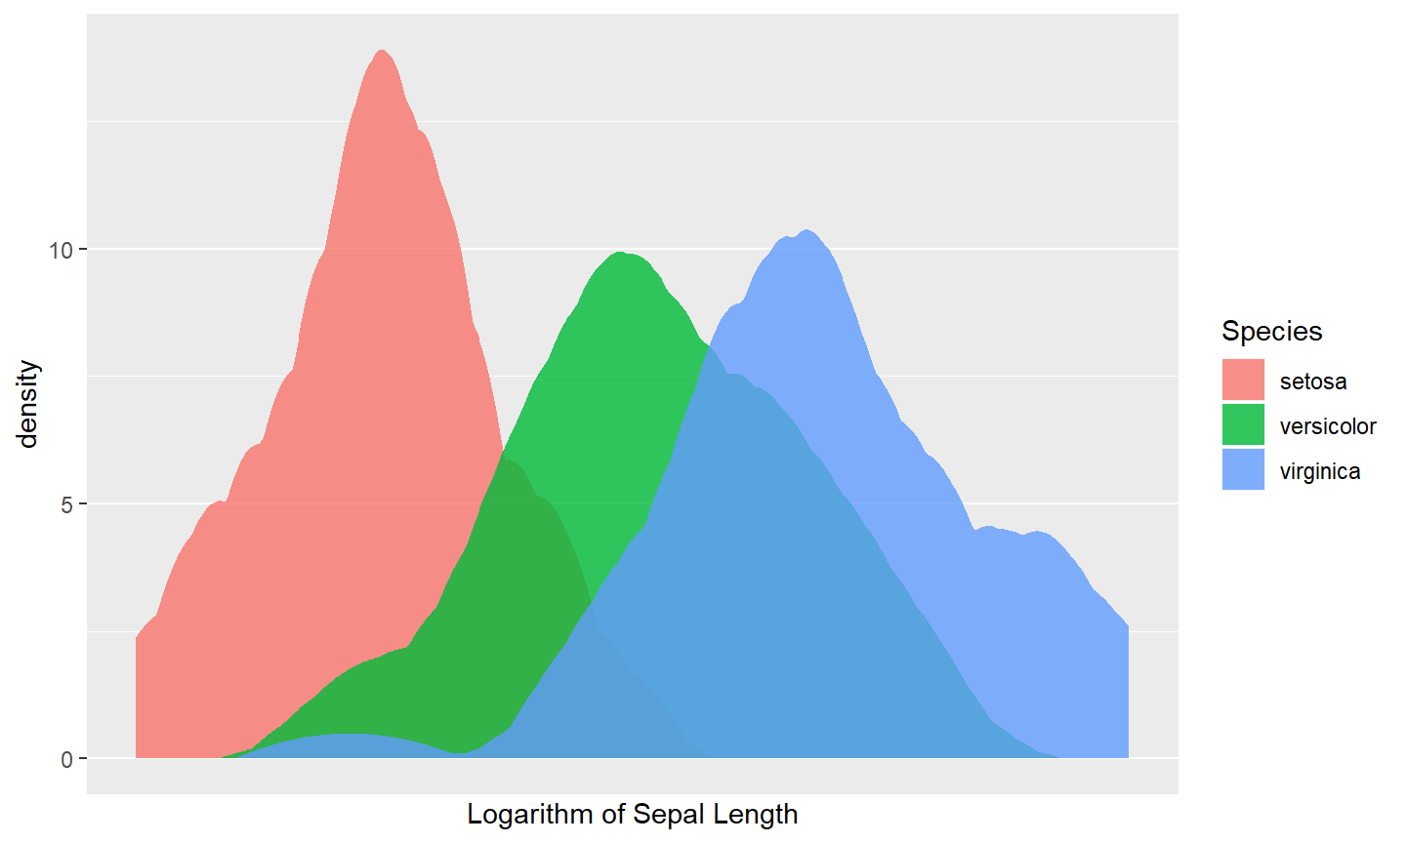
Graphical tools in R
Ggplot2 package: based on grammar of graphics, close to publication quality

Slide 32
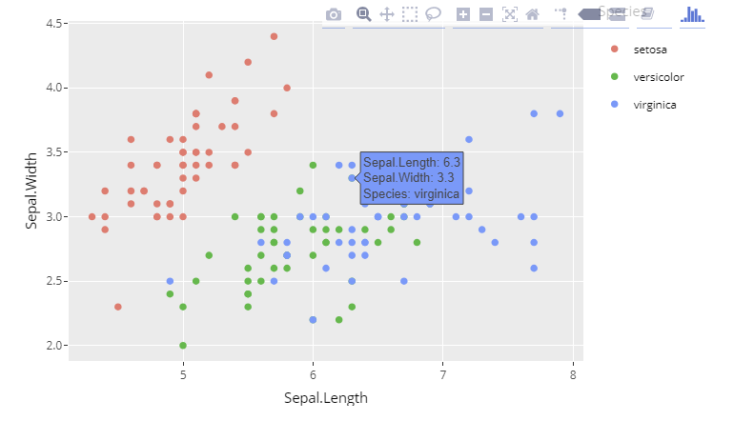
Graphical tools in R
Plotly package: Ggplot2 + interactivity

Slide 33
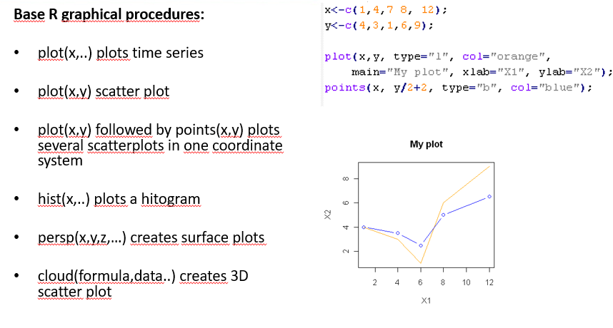
Graphical tools in R
Ggplot2 package: based on grammar of graphics, close to publication quality

Slide 34
Galgotias University
THANK YOU
THANK YOU

